Slide 1

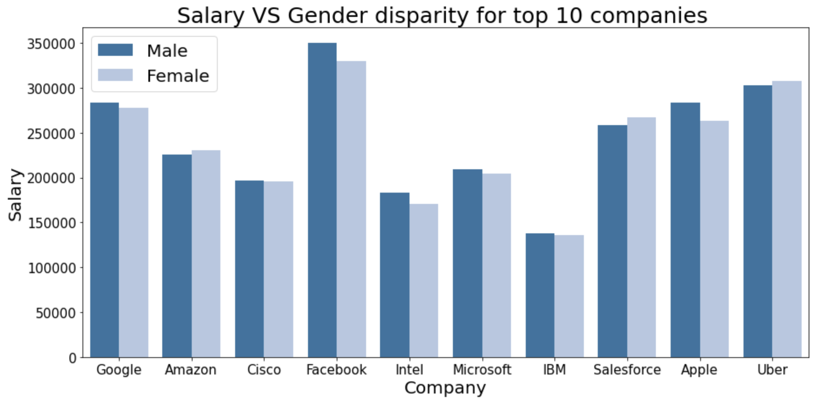
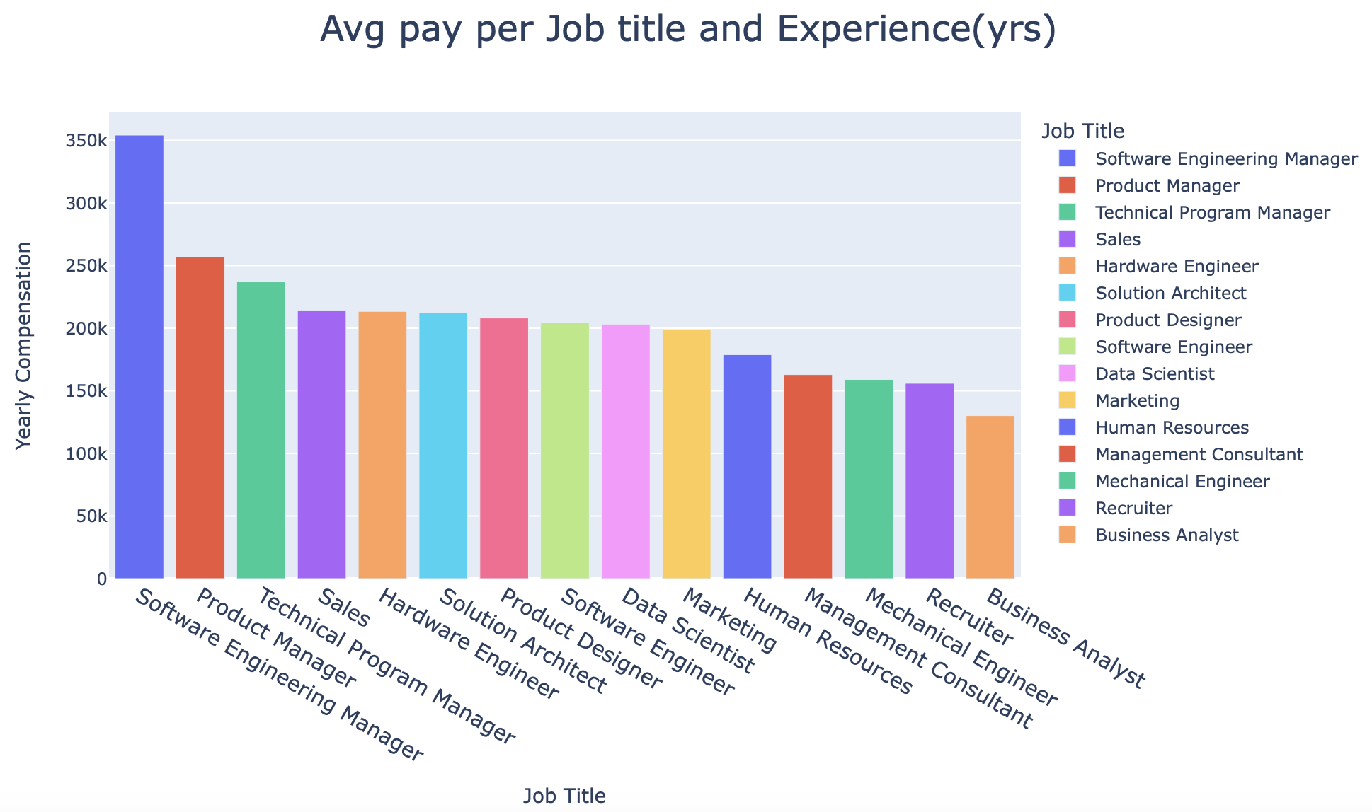
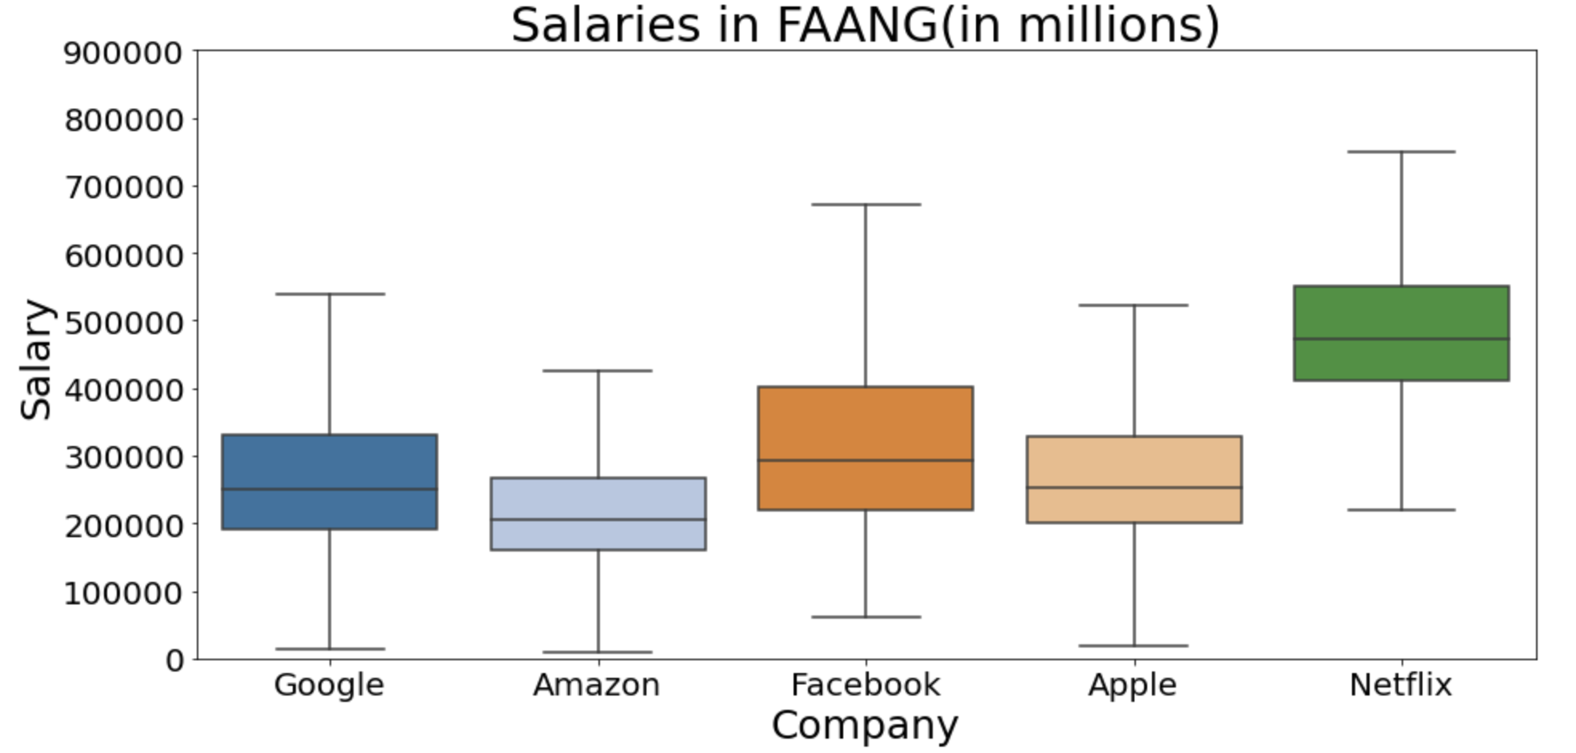
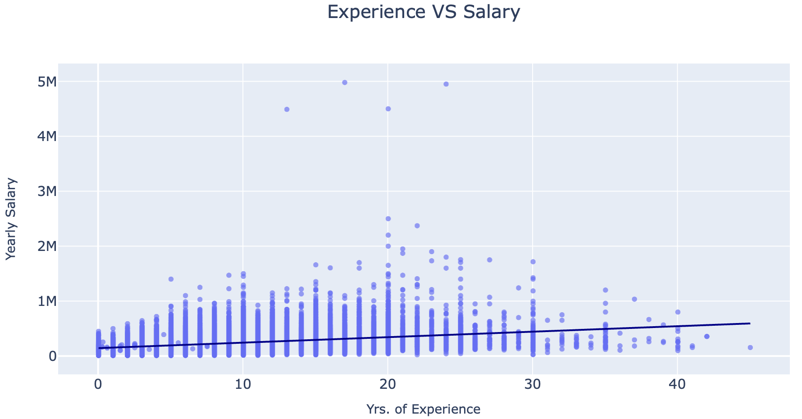
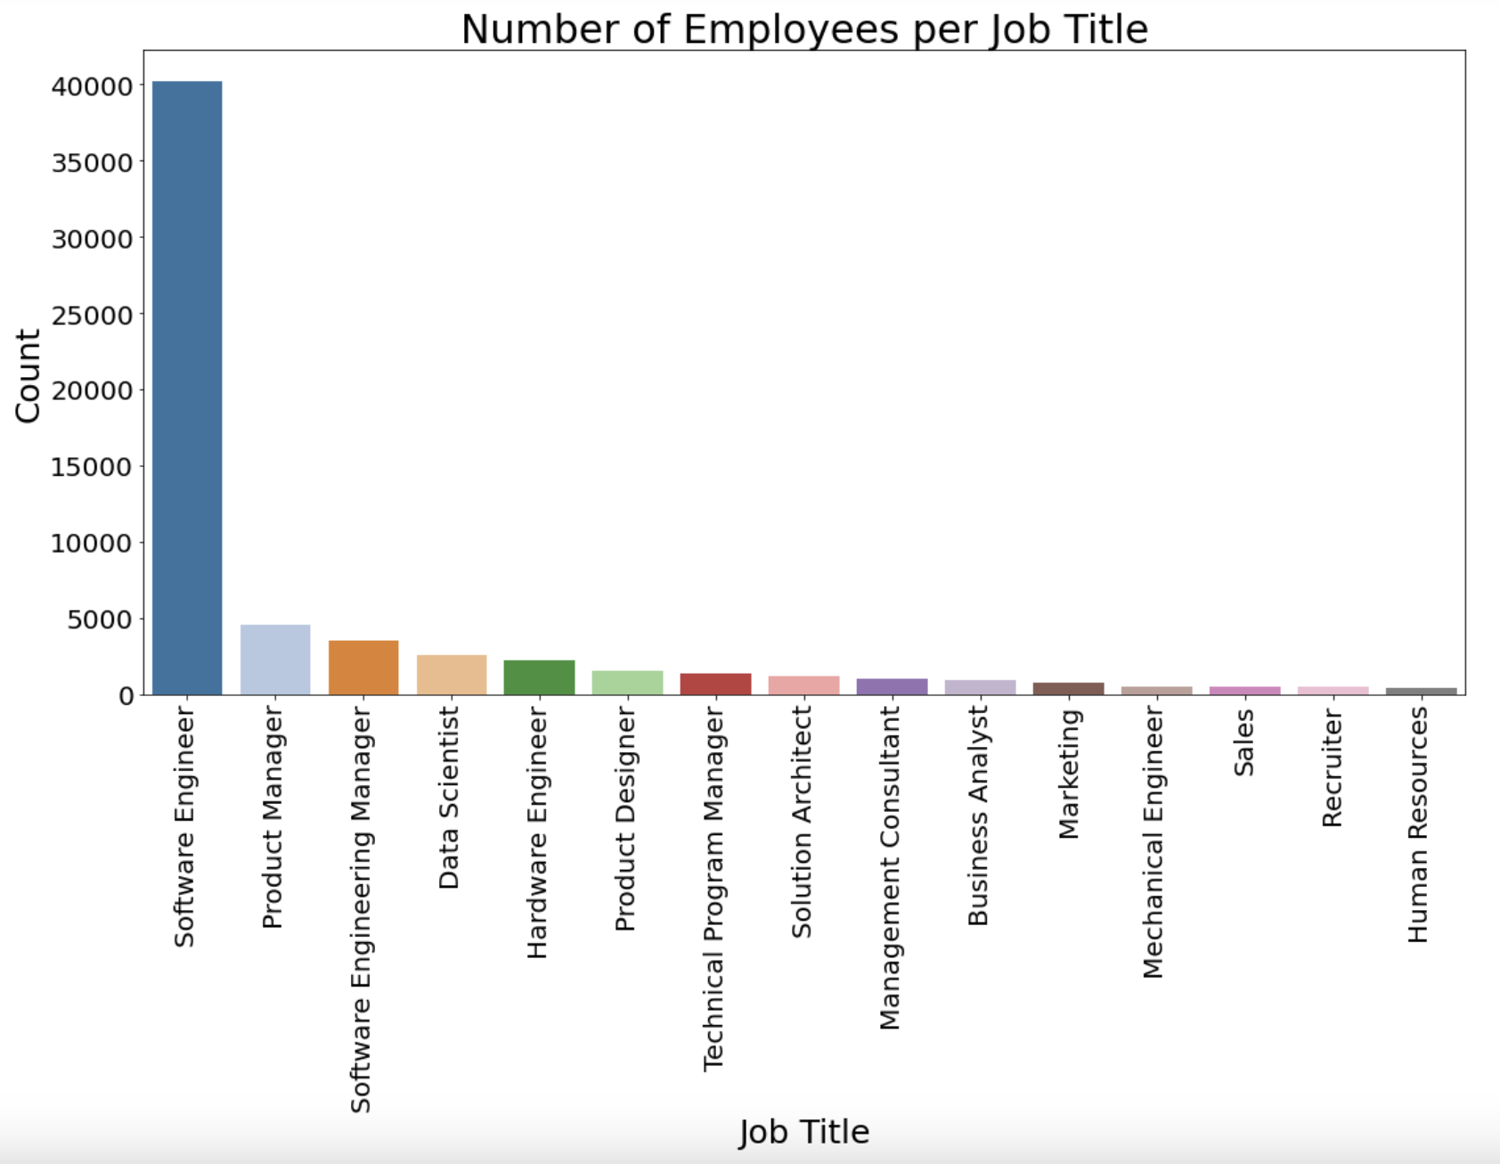
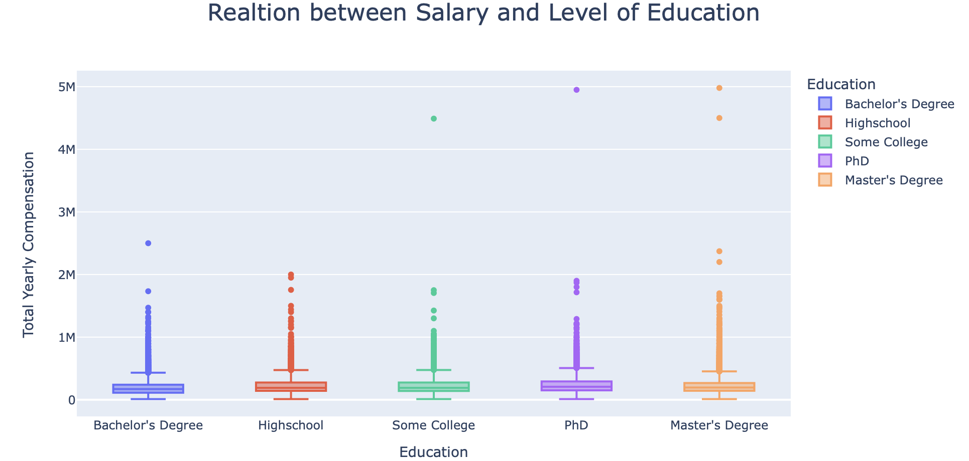
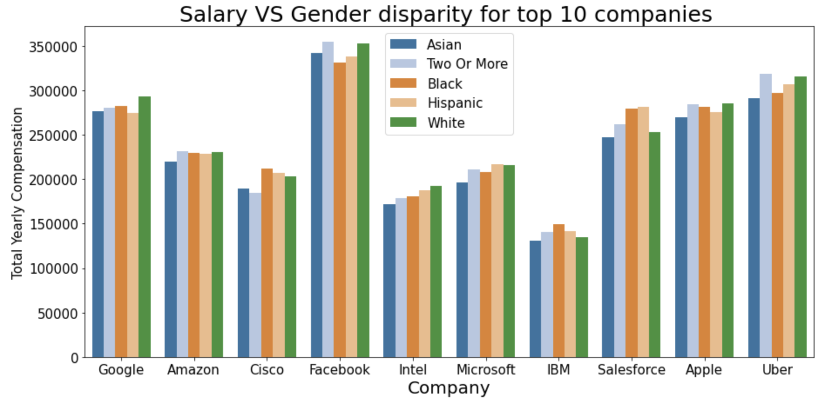
Analysis of STEM salaries
Kunal Pradeep Gandhi
Introduction:
Surprisingly, there is no direct relation between Salary and Education. Though one thing to note is that with PHD degree, overall, the total yearly compensation is slightly higher than rest of the degrees. Since there is no direct relation between Salary and Education we will not be using Education as one of our modelling parameters. If not education let’s check out compensation with respect to Job title and yrs. of experience.
Turns out, there is no disparity with respect to race. There is also no salary disparity with respect to gender.
Students are always curious about the salaries their STEM degrees can fetch. The purpose of this project is to analyze the total compensation(salaries) based on Gender, Education and Job title for STEM salaries. The objective is to perform EDA and build a regression model that can predict these salaries.
Questions Addressed:
1. Is there a relation between salary and education?
2. What is the yearly compensation based on Job title?
3. Is there a relationship between experience and salary?
4. Is there a salary disparity due to Race?
5. Is there a salary disparity due to Gender?
6. What are the typically salaries at FAANG?
7. Which is the hottest job title with respect to number of employees ?
Do not forget to provide insights
These companies are paying handsomely to their employees. Though, students are always fascinated about the yearly compensation for FAANG companies. Let’s see how much are they paying typically to their employees.
Conclusions
Summary of study.
Who is in need? Of what?
What data was analyzed? From where?
What did you do to extract insights?
Insights extracted?
Implications for decision makers
Data Understanding/ Methods:
Data Source: Kaggle
Data Description: The data comprises of 60K+ data points having information about STEM salaries and information on several parameters; gender, race, location, education, stock values, job title, yrs. of experience, level, bonus, stock grant value etc.
EDA Process: The process is divided in 4 phases
Discovery: Familiarizing with data
Cleaning: Removing Null values, mis-spellings, outliers and duplicates
Validating: Verifying if the data is consistent
Analysis: Performing in depth analysis for seeking relationships or trends
Modelling:
1. Structuring the cleaned data set
2. Label Encoding
3. Splitting the dataset into training set and test set
4. Scaling our feature and target variables with respect to their interquartile ranges using Robust Scaler
5. Using regression model to fit the data and make predictions
Manager roles are paid significantly higher than the rest of job roles. Other than Manager roles, 5-8 years of experience in any job role fetches salary above $ 200K. Business Analysts are paid lowest salaries even with 5 years of avg. experience. Here the years of experience and job title does play a significant role in the typical average base compensation. Hence Job title will be our modelling parameter .Checking out correlation between number of years and salary would therefore be intriguing.
Netflix comparatively pays higher salaries than other FAANG companies, over 400K. Google, Amazon and Facebook typically pay employees well over 150K in total compensation
Facebook employees have the highest salary range, from 200K to 400K. Finally, lets check out what job title is the hottest with respect to the number of employees. Turns out, Software Engineer followed by Data Scientist are the hottest job roles.
Future Work
How can you expand the project?
What would you need to extract more insights?
What type of insights can be extracted>
There is mostly a positive correlation between years of experience and total yearly compensation. Therefore, we will use years of experience as a modelling parameter. Let’s check out for any disparity with respect to race and gender.
References
Reference 1
Reference 2
Reference 3
Reference 4
Reference 5
Reference 6
etc
Visualizations:

